Slide 1
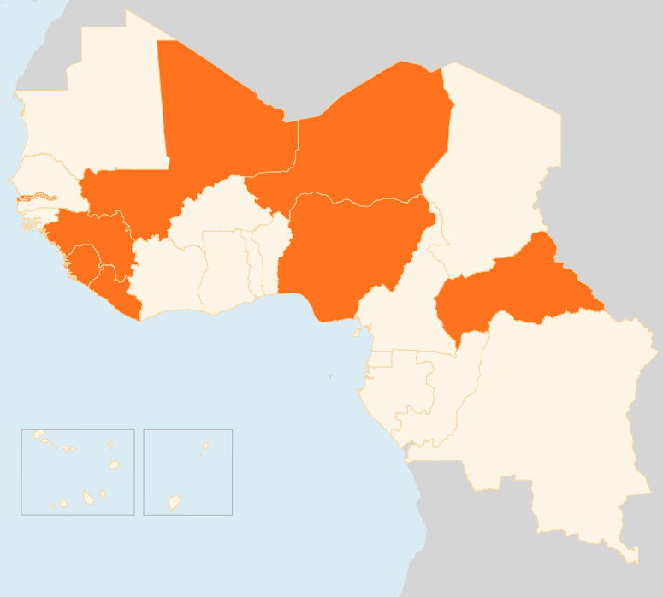


12 - 18 May 2015
CENTRAL AFRICAN REPUBLIC
357 CHILDREN RELEASED BY ARMED GROUPS
Armed groups on 15 May released 357 children, many younger than 12 years following a UNICEF-facilitated agreement with the leaders of anti-Balaka and ex-Seleka militants. UNICEF and partners have begun providing psychosocial support and working to reunite the children with their families and will be supporting their reintegration into the community. This is the single largest release of children associated with armed groups in the Central African Republic since violence erupted in 2012.
GUINEA
NEW EVD HOTSPOTS IDENTIFIED
Following the identification of two new hotspots - in the western Boké Prefecture near the border with Guinea-Bissau and Dubréka Prefecture near the capital Conakry - the National Coordination (on Ebola) on 15 May announced measures to strengthen surveillance and contact tracing. These include alerting all the prefectures whenever a contact is reported missing; action against contacts that intentionally move to other regions; setting up a rapid intervention team to be deployed to new hotspots; and renewing the contracts of personnel tasked with surveillance in some districts.
NIGER
ANTI-IMMIGRANT SMUGGLING LAW PASSED
The Nigerien parliament on 11 May unanimously approved a law against the smuggling of migrants, becoming the first country in the region to pass legislation specifically against migrant smuggling. The country’s central town of Agadez is one of the main transit points in the Sahara for migrants leaving West Africa towards Libya with Europe as the final destination. In late April, more than 400 illegal migrants were detained in Agadez and repatriated to their countries of origin.
NIGERIA
ARMY SAYS DESTROYED BOKO HARAM CAMPS
The Nigerian Military said it demolished 10 Boko Haram camps and seized several armoured vehicles and weapons in the insurgents’ north-eastern Sambisa Forest hideout on 16 May. An offensive by Nigeria and neighbouring countries have dealt a blow to the militants whose insurgency has triggered massive displacement and humanitarian crisis in the region.
MALI
6,200 DISPLACED BY CLASHES
More than 6,200 people have been displaced in Gourma Raghous area in Timbuktu Region following attacks by armed groups on villages along River Niger between 8 - 12 May, according to local authorities. An unknown number of people have also been displaced in Timbuktu’s Goundam area following clashes between the military and fighters of the Coordination of Azawad Movements (CMA). Humanitarian access is difficult due to insecurity.
PEACE DEAL SIGNED WITHOUT MAIN REBELS
The Malian government on 15 May signed a peace agreement with five armed groups, but the main Tuareg-led CMA rebels did not ink the deal despite initialling it a day earlier. The CMA is reportedly demanding an amendment recognising "Azawad", the name used by the Tuareg for the northern part of Mali, as a "geographic, political and juridical entity".
REGIONAL / EBOLA VIRUS DISEASE
INFECTIONS INCREASE
A total of 23 newly confirmed cases were reported in Guinea in the seven days to 15 May, compared to nine in the previous week. In Sierra Leone, six new cases have been reported since the country went for eight consecutive days (6 - 13 May) without recording any confirmed infections. Meanwhile, in Liberia, where Ebola was declared over on 9 May, 13 suspected cases were reported in Montserrado and Bomi counties in the past week, but none tested positive.
MALI
6k
DISPLACED BY FIGHTING
NIGER
ANTI-IMMIGRANT SMUGGLING LAW PASSED
NIGERIA
ARMY SAYS DESTROYED BOKO HARAM CAMPS
CAR
357
CHILDREN FREED BY MILITANTS
REGIONAL / EVD
GUINEA
INFECTIONS INCREASE
NEW EVD HOTSPOTS IDENTIFIED
Creation date: 19 May 2014
Map data sources: UNCS, DevInfo, OCHA.
The boundaries and names shown and the designations used on this map do not imply official endorsement or acceptance by the United Nations

